Slide 1


Pune Institute of Computer Technology, Pune Dept. of E&TC
304196: Employability Skills and Mini Project (ESMP) (2015 Course)
Stage Lighting System
Guided By: Mr.V.B.Vaijapurkar
By:
Sampreeti Saha(32255)

Slide 2
Block Schematic
Power Supply
Gear Assembly
and Motor
Motion Sensor
Microcontroller
Driver
Stage lamp

Slide 3
Resources Required
Hardware
Microcontroller
RGB LED
Stepper Motor
Motion Sensor
Rack and Pinion Gear Set
Driver Motor
Software
Proteus : Circuit Simulation
Kiel 4.0 : Microcontroller Programming

Slide 4
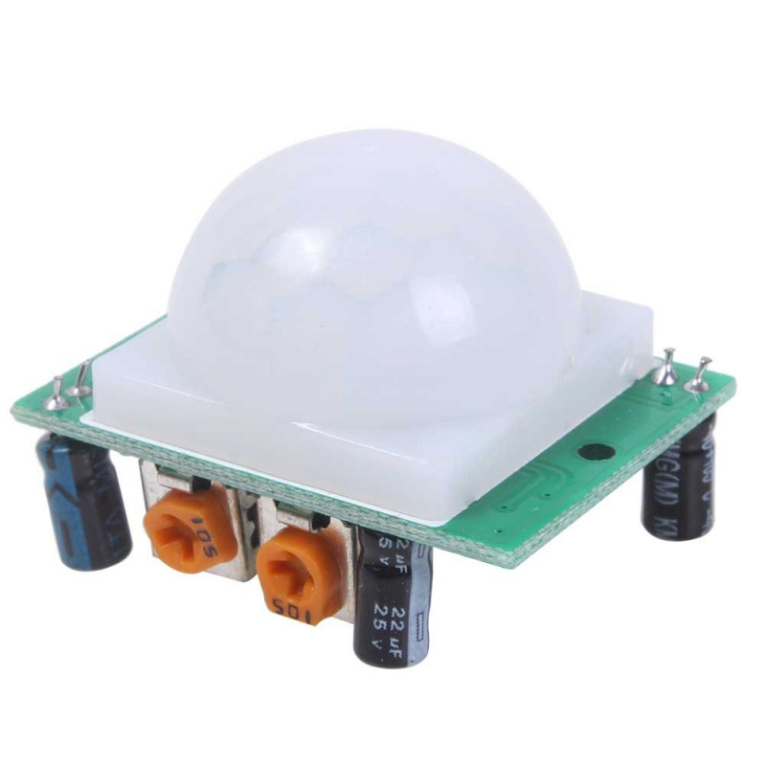

Working model Animation
Microcontroller
L
S
R
Rack and Pinion Arrangement
Stage

Slide 5
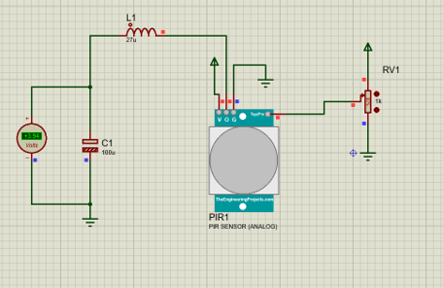
Testing the PIR Sensor

Slide 6
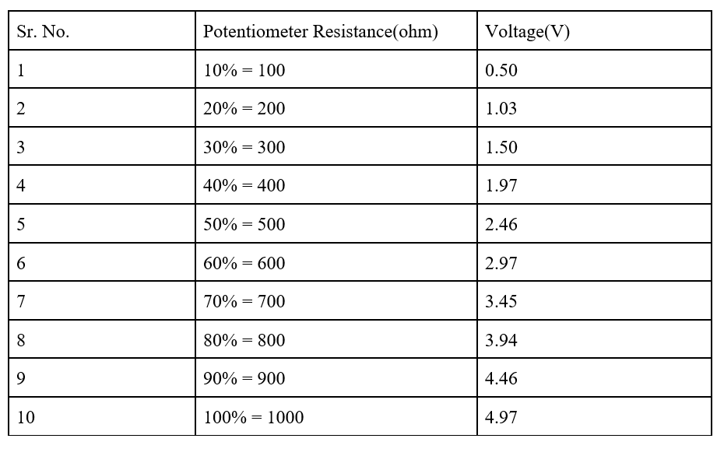
Observations

Slide 7
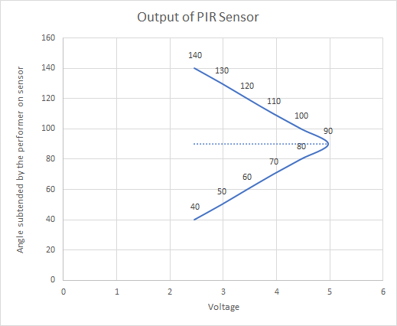
Graphs

Slide 8
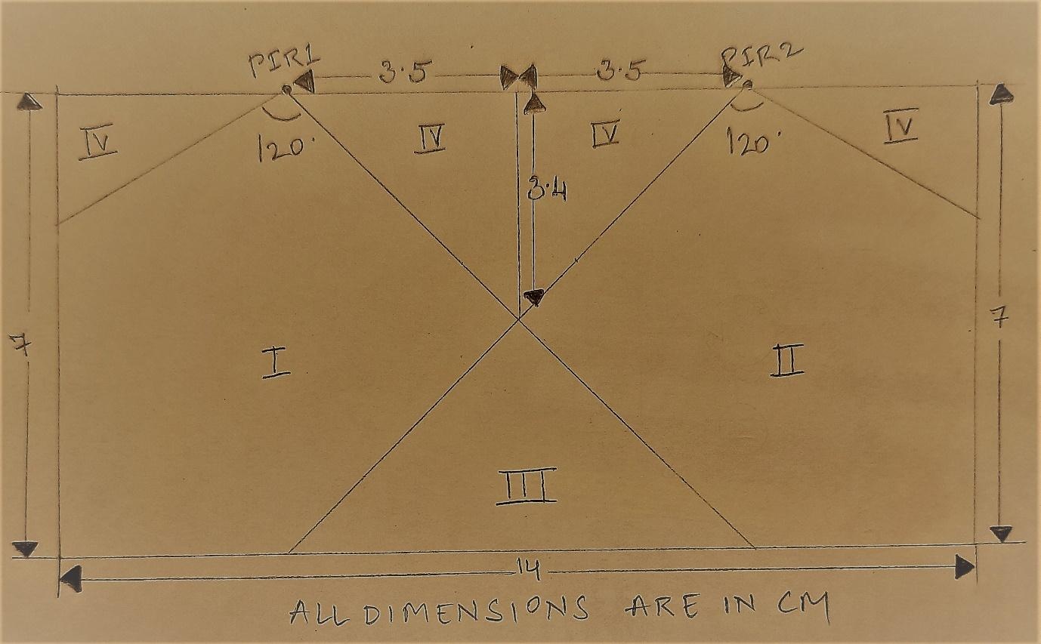
Analysis

Slide 9
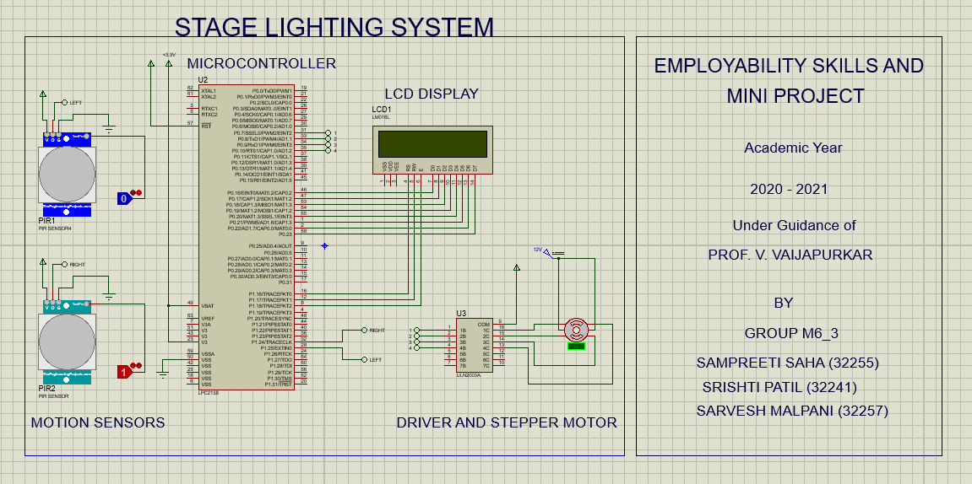
Simulation

Slide 10
Features
Using motion sensor input microcontroller can control the movement of spotlight mounted on gear assembly
Spotlight can traverse across the stage in a fixed horizontal path according to rotation of stepper motor
This system helps in saving power used by the theatre lights

Slide 11
Future Scope
The color of the spotlight may be changed from
the fixed white tone , according to the scene on
stage
The change of color may be automatic using camera as a sensor to detect the facial expressions of the main actor.

Slide 12
Conclusion
Through this project we learnt about the LPC2148 microcontroller and its interfacing with switches, stepper motor and ULN2003 and most importantly about the PIR Sensor which helps in motion detection.
We hope that this project will help improve the experience of actors as well as production houses in the theatre business and be a visual treat for the theatre audience in the future.

Slide 13
References
Books
ARM Simplified: with LPC2148 by Prof K Subramani
Websites
https://www.nxp.com/docs/en/data-sheet/LPC2141_42_44_46_48.pdf
https://cdn-learn.adafruit.com/downloads/pdf/pir-passive-infrared-proximity-motion-sensor.pdf
https://www.digikey.be/htmldatasheets/production/1845166/0/0/1/LED-RGB-Disk.pdf

Slide 14
Thank You

